Slide 1



ECE 4300.01 Computer Architecture Group A
Ella Shepherd, Aaron Tran, Max Gross, Anish Chinnakonda

Slide 2
PROMPT 1
“Studying the complete benchmarking of the SHA-2/SHA-3 hash functions on softcore processors (NIOS/Intel, MicroBlaze/AMD, or RISC-V architecture created by UC Berkeley)”

Slide 3
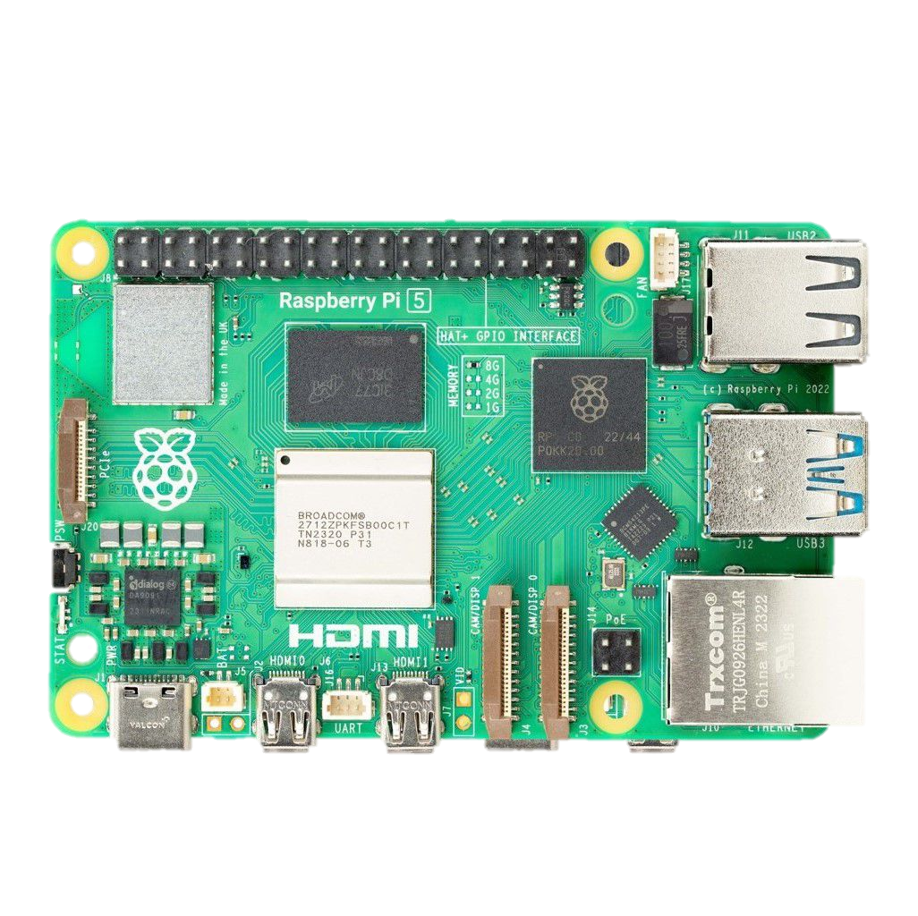
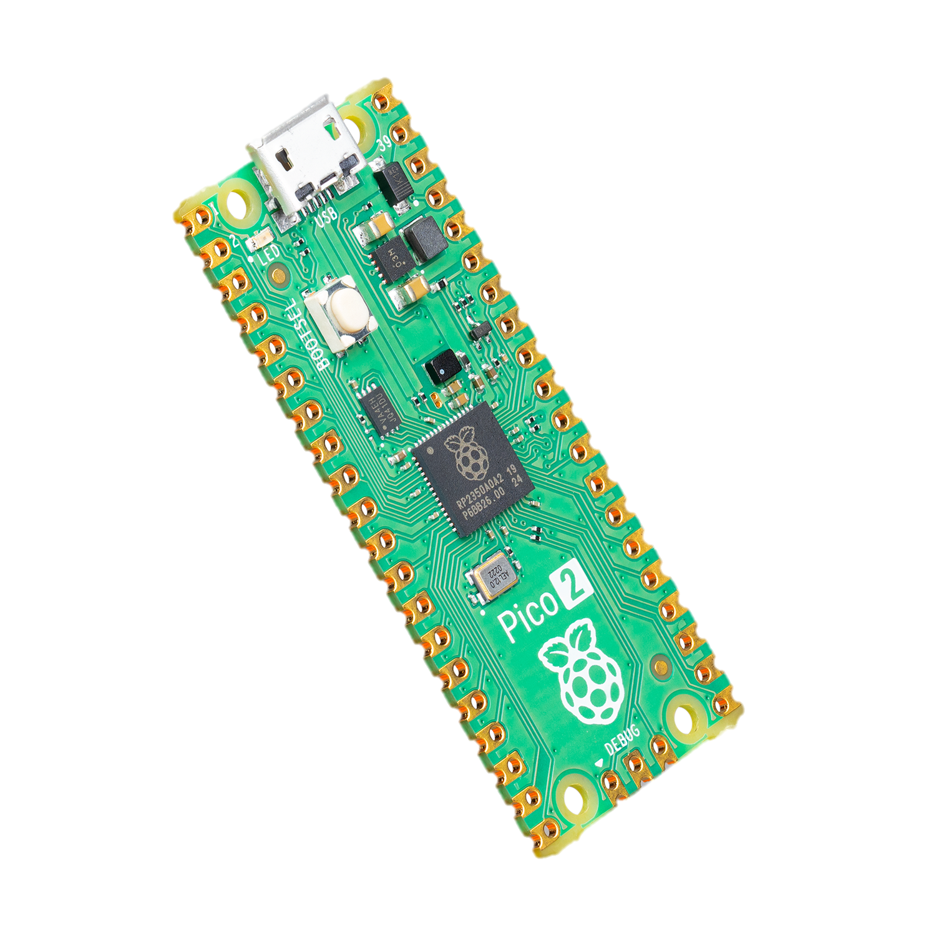
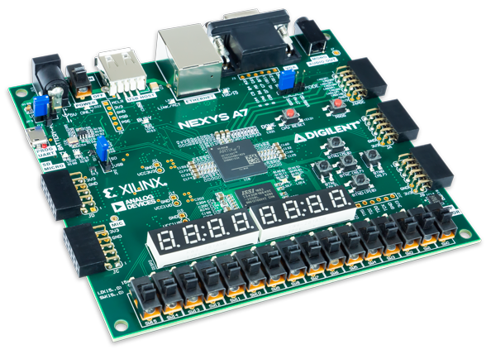
Nexys a7 Raspberry pi pico 2 raspberry pi 5
Microblaze Riscv Arm
With
With
With

Slide 4
Testing Criteria
Implementing to get a hash of 16 Kbytes repeatedly, then listening for power to log how much time it takes.
Doing this by testing for…
16 Kbytes for 3 seconds
USB C for power measurements

Slide 5
Nexys a7 with Microblaze
100 MHz FPGA Softcore Microcontroller
Microblaze V – a Risk-V based architecture
AXI bus
AXI UARTLite @9600 Baud
AXI Hardware Timer
AXI Interrupt Handler
AXI SHA256 Hardware Accelerator

Slide 6
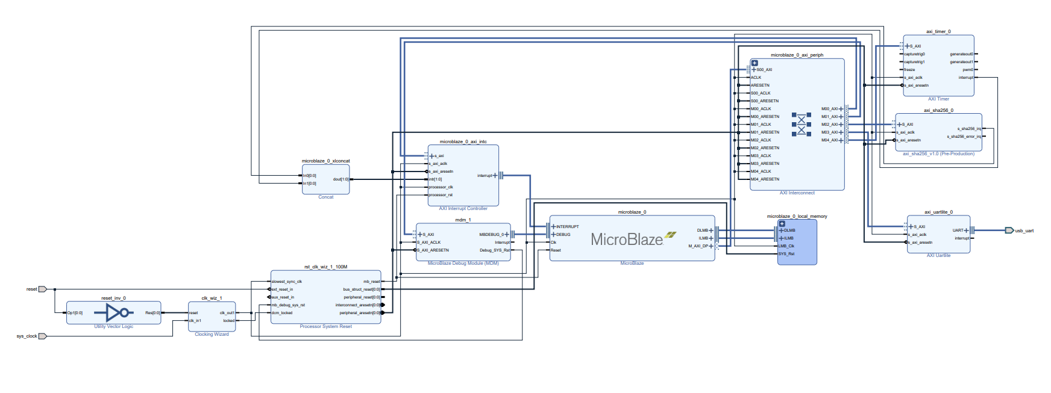
Microblaze Block Diagram

Slide 7
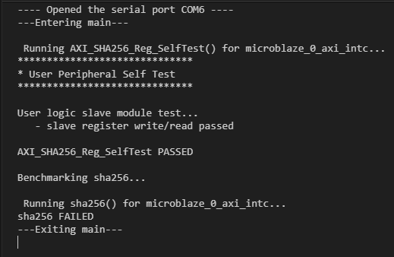
Current Progress - Microblaze
Source Code Provided Compiles
AXI Registers are Read/Writable and pass SelfTest()
Unable to create a hash

Slide 8
Raspberry pi pico 2 with Riscv
Raspberry Pi Pico 2 uses the RP2350 MCU with 520 KB SRAM, 4 MB flash, and 150 MHz dual-core performance.
Supports both Arm Cortex and RISC-V cores. RISC-V selected for all benchmarking.
Benchmarking SHA-2 (SHA-256/512) and SHA-3 (Keccak) hash functions entirely on RISC-V.
Perform power analysis by monitoring current on VSYS during hash computations at set frequencies.
Generate performance vs energy plots comparing software and hardware-accelerated SHA-256 runs.

Slide 9
Example: Raspberry pi 5 with Arm
•Physical Hardware block built into the System on Chip of the Raspberry PI 5 inside the ARM Cortex-A76 CPU on the PI’s Broadcom BCM2712
•Utilizes ARMv8-A Cryptographic Extension on ARM Cortex-A76 CPU
•Processes cryptography in hardware crypto extension much faster than the CPU could do in software. The main OS is not involved beyond normal scheduling.
•OpenSSL libraries route the crypto instruction to the hardware engine so that the main OS doesn’t have to perform the cryptography instruction.
•Capable of executing AES(Advanced Encryption Standard)/SHA(Secure Hash Algorithm) instructions on the ARM crypto extension
•Supports AES encryption/Decryption and SHA-2 and SHA-256

Slide 10
Upcoming, Due 11/26
Course Project | Deliverables
1) Document subfolder: | Final IEEE Formatted Report
2) Code Subfolder: | Any codes or profiling tools used during the project will be added under this subfolder
3) Presentation subfolder: | Presentation Slides Video Presentation Recording Slider Presentation Poster (leverage the importance of the work that the project has done)
4) Demo Folder: | An interesting demo recorded as a video, which shows an exciting part of the project with running example on the code is developed or used by the team

